Slide 1
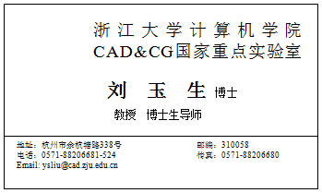
手 机：130-9378-1234
办公室：紫金港国会中心520室

Slide 2
Lesson 4: Introduction of UML
4.1 Introduction of Object-oriented Technology
4.1.1 Software engineering and software crisis
4.1.2 Characteristics of software
4.1.3 Complexity and its control of software
4.1.4 Object-oriented Technology
4.2 Introduction of UML
4.2.1 Definition of UML
4.2.2 History, characteristics, and constitutes of UML
4.2.3 Views of UML
4.2.4 UML application domains and common tools
4.2.5 UML examples
4.3 UML Conclusion

Slide 3



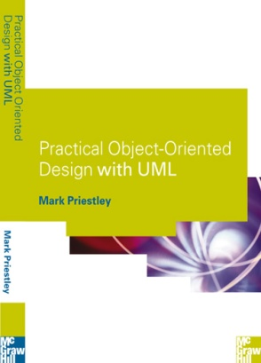
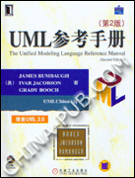
Text Book & Reference
Textbook：
  UML USER GUIDE（ English version, 2nd )
  Grady BOOCH, James RUMBAUGH, Ivar JACOBSON
  (机械工业出版社)
Reference：
  《UML用户指南》 第2版 Grady Booch等著 邵维忠等译 人民邮电出版社
  《面向对象技术UML教程》
  王少锋编著 清华大学出版社
  《面向对象设计UML实践》Mark Priestley著 龚晓庆、卞雷等译 王少锋审 清华大学出版社
  《Practical Object-oriented Design with UML》 Mark priestley 2th Edition 清华大学出版社
  《UML与Rational Rose2002从入门到精通》 Wendy Boggs等著 邱促潘等译 电子工业出版社

Slide 4
4.1.1Software Engineering- Our Major
Software + Engineering
What is Engineering ?
Is the discipline, art, and profession of
acquiring and applying scientific, mathematical, economic, social, and practical knowledge
To design and build structures, machines, devices, systems, materials and processes
That safely realize solutions to the needs of society.
American Engineers' Council for Professional Development
The creative application of scientific principles
To design or develop structures, machines, apparatus or manufacturing processes, or works utilizing them singly or in combination;
Or to construct or operate the same with full cognizance of their design;
Or to forecast their behavior under specific operating conditions; all as respects an intended function, economics of operation and safety to life and property.

Slide 5
4.1.1 Main branches of engineering
Mechanical engineering
Electrical engineering
Civil engineering
Chemical engineering
Management engineering
…….

Slide 6
4.1.1 Software Engineering
Software engineering (SE) is a profession dedicated to
Designing
Implementing
modifying
So that it is of
Higher quality
More affordable
Maintainable
Faster to build
software
It is a “systematic approach to the analysis, design, assessment, implementation, test, maintenance and reengineering of software”
The application of engineering to software
It integrates significant mathematics, computer science and practices whose origins are in Engineering

Slide 7
4.1.1 Aim of Software Engineering
Software – Coding
Software – Satisfying the user requirement
Software – High-quality
Software – within the time limit
Software – Within the cost limit
Aim of Software Engineering
Within the limited time and cost, developing the high-quality software system satisfying the user’s requirements

Slide 8
4.1.1 Software Crisis
General process of software development
  Technical-Level：Process division and control
    Software requirement
    System-level Design
    Sub-system-level Design
    Detailed design
    Coding
    Test
    Delivery
    Maintanance
    Re-engineering
  Management Level：Source management
    Hardware resource
    Software resource
    Human resource

Slide 9
4.1.1 Software Crisis
Development method
  Waterfall Model
  Rapid Prototype Model
  Spiral Model
  Evolutionary Model
  Incremental Model
  Fountain Model

Slide 10
4.1.1 Software Crisis
Characteristics of Software crisis
  Low efficiency
  Low quality
  Hard to maintain
  Hard to replant
  Over-high development cost
  Long development cycle

Slide 11
4.1.2 Characteristics of Software
Form：Unseen, Invisible, Untouchable
Hard to decide whether good or bad.
Production mode：Logical product. Is related to the designers’ thought mode & Intelligence. How to communicate is very imperative.
Product requirement: Cannot have any error. Need Higher quality insurance systems
Maintenance mode: Haven’t spare parts，Bug patch will induce new Bug. Maintenance is very hard.

Slide 12
4.1.2 Inherent complexity of software
Simple hardware and complex software
  Induced by von Neumann architecture — all functional requirement depend on software
Intellectual activity, hard to describe
  It is difficult to find a good method and tool to describe the inherent essential characteristics and rules of a software system.
Interaction, geometrically increasing
  The interactions among different elements in software system are uncertain. And with the increase of the elements, interactions between them increase nonlinearly and dramatically
Change, change, change, ……
  Face continuous change, Face eternal requirement of change
  The lifetime of the software is longer than that of the hardware, which affects the requirement of the software

Slide 13
4.1.3 Control the complexity
Decomposition——
Abstraction——
  Process abstraction
  Data abstraction
Modularity ——Building block
  High inner cohesion
  Low coupling
Encapsulation

Slide 14
4.1.3 Control the complexity
Modeling
  A model is a simplification of reality
Why Modeling is necessary
  We build models so that we can better understand the system we are developing
Dog house → house for family → high-rise office building
For software, the problem is more than just a matter of writing lots of software --- in fact, the trick is in
    Creating the right software
    Figuring out how to write less software

Slide 15
4.1.3 Control the complexity
A proven and well-accepted engineering technique
Function of Modeling
  Visualize
  Specify
  Guide
  Document
  Analyze
  Divide-and-Conquer
Modeling everywhere & every time

Slide 16
4.1.4 Object-oriented Technology
Traditional structure method（functional decomposition）
  Functionally decomposition for the given problems
    If the decomposed function is still too large, continuously decompose until it is convenient to be treated and understand
Object-oriented method
  Naturally decompose the problem-- Similar to designer’s thinking mode.
  Directly describe the real world as much as possible
Object-oriented(OO）Technology
  Decomposition, abstraction, modularization, encapsulation.

Slide 17
4.1.4 Advantages of OOT
Stable
  Small req. change NOT → Large system structure change
Easily understood
  Is the same mapping of the real world.
  For structured method, real world → Function group
Adaptable
  Apt for user’s req. change
  Suitable for constructing large software systems
Reliable
  The same concept and representation used for analysis and design

Slide 18
4.1.4 Basic Concepts of OOT
Class
  A group of object with the same attributes and methods
  Class is static, Objects are dynamic
Object &Instance
  A object is comprised of a group of attributes & related operation
  The instance of class is object. The instance of association is link
Encapsulation
  Two parts of objects：Interface & Implementation
  Prevent the user from operating the internal details directly . Thus the change of implementation will not affect the client part.
Name
Part
-name:String -number:long -cost:double
+Part(nm:String,num:long, cst:double) +getName():String +getNumber():long +getCost():double
Attribute
Attribute Value
myScrew:Part
name=“screw” number=28834 cost=0.02
Operation

Slide 19
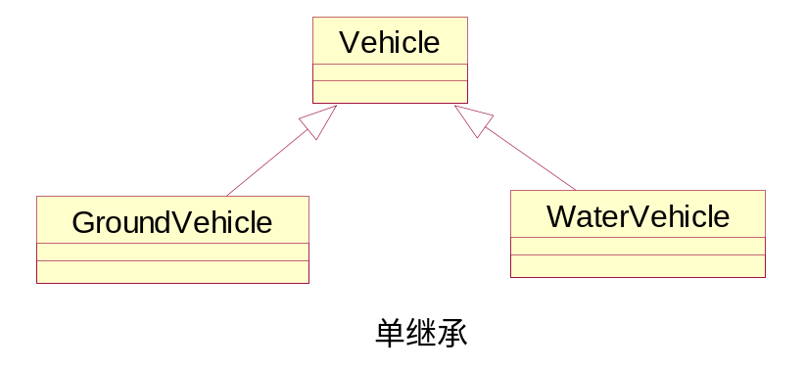
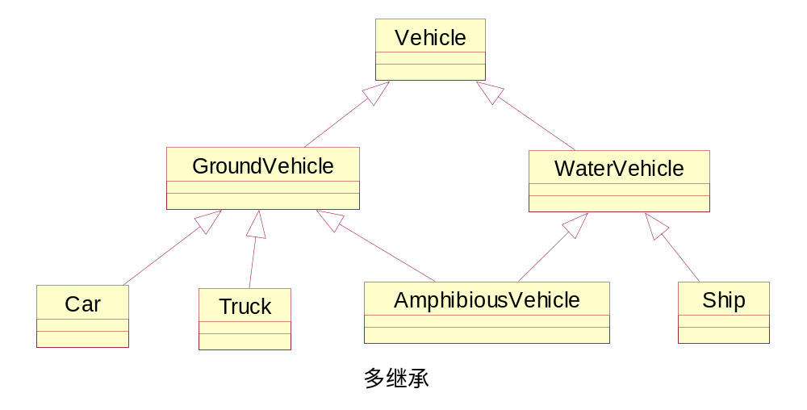
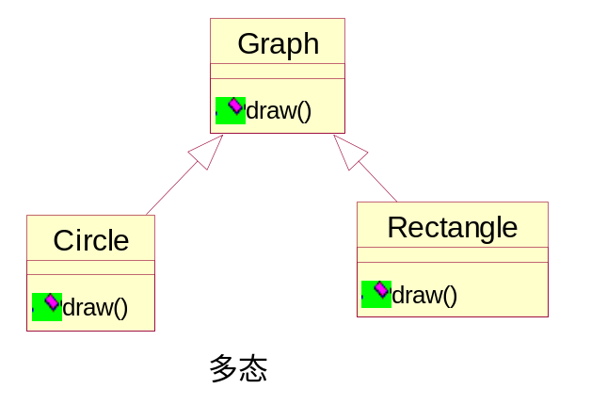
4.1.4 Basic Concepts of OOT
Inheritance
  Child class/Parent class，Special class/Generic class，Derivation class/Basic class
  Override & Overload
Polymorphism
  Override & Dynamic binding
  Enable the system to be good adaptability
Message
  Communication mode between objects. Different function call.
  Synchronous message and asynchronous message
Override example
public class A {
String name;
public String getValue() {
return “Value is:” + name;
}
}
public class B extends A {
String address;
public String getValue() {
return “Values is:” + address;
}
}

Slide 20

4.1.4 Conclusion -- OOT
Software Crisis
  All methods for software development
  Software crisis still exists, software quality, Production efficiency…….
Crisis origin —— Intrinsic complexity of software
  The intrinsic complexity of software is determined by its characteristics
  Inducing: high cost, postponed delivery, low-level quality……
Solution idea —— Control complexity
  Cannot eliminate the complexity completely → Have to control the complexity to reduce the effect of software complexity to software development.
  Decomposition, Abstraction, Modularization, encapsulation
Solution method—— Object-oriented
No Silver Bullet !!
—— “The Mythical Man-Month: Essays on Software Engineering”， Fred Brooks
没有银弹！！
—— 《人月神话》,弗雷德里克·布鲁克斯
Notes:
没有银弹

Slide 21
4.2.1 Definition of UML
UML is a standard language for writing software blueprints
UML is used to Visualize, Specify, Construct, Document the artifacts of a software-intensive system.
  Artifact：
    All the things during software development: Model, code, test case……

Slide 22
4.2.1 UML is a language
Vocabulary + Rules
Is just a modeling language
Can tell you how to create and read well-formed models
Cannot tell you what models you should create and when you should create them → The task of a well-defined process

Slide 23
4.2.1 UML is a language for Visualizing
You think it, you code it –No modeling?? No!!
Three problems without uniform-language modeling:
Error-prone communication
Hard to understand with only textual words-- A Picture Paints a Thousand Words
Conceptual knowledge Lost -- The palest ink is better than the best memory

Slide 24
4.2.1 UML is a language for specifying
Specifying means building precise, unambiguous and complete models
Analysis
Design
Implementation

Slide 25
4.2.1 UML is a language for constructing
Is not a visual programming language
Can map from a model in the UML to a programming language such as JAVA, C++, VB… → Forward Engineering
Reverse Engineering? Also OK!!
Direct execution of models, the simulation of systems, the instrumentation of running systems

Slide 26
4.2.1 UML is a language for documenting
Requirements
Architecture
Design
Source code
Project plans
Test / Test case
Prototypes
Release
……..

Slide 27
4.2.1 Where used?
Software-intensive systems
  Enterprise information systems
  Banking and financial services
  Defense/aerospace
  Retail
  Distributed Web-based services
  …….
Non-Software systems
    Workflow in the legal system
    Design of hardware
    Mechanical system
    ……

Slide 28



4.2.2 UML历史
Current
UML2.0
2003.3
UML1.5
Industrialization
2001.9
UML1.4
1999.6
UML1.3
1997.9
UML1.1
Standard
1997.1
UML1.0
Suggestion from UML Cooperator
1996.6 & 10月
UML0.9 & 0.91
Uniform
1995. Int. Conf. of OOPSLA
Grady Booch James Rumbaugh Ivar Jacobson
UML Amigo
Unified Method 0.8
Booch’93
OMT-2
Competition
Other methods
Booch’91
OMT-1
OOSE

Slide 29
4.2.2 Characteristics of UML
Uniform standard
  Standard modeling by OMG
Object-oriented
  Support object-oriented software development
Visualization & Strong representation
Independent of modeling process
  Not depend on specific software development process
Easy to understand– Explicit concept, Concise modeling, Clear structure

Slide 30
4.2.2 The Conceptual Model of UML
structural thing
behavioral thing
thing
grouping thing
annotational thing
dependency
Basic building block
association
relationship
generalization
realization
use case diagram, sequence diagram
name
diagram
collaboration diagram, class diagram, object diagram,
scope
Rule
state chart diagram, activity diagram,
visibility
component diagram, deployment diagram
integrity
execution
specification
Common mechanism
adornment
common division
extensibility mechanism: stereotype, tagged value, constraint

Slide 31
4.2.2.1 Structural Things
The nouns of UML models
Static parts of a model
Represent conceptual / physical elements
Called as Classifiers
<<interface>>
IWindow
Window
open()
close()
move()
display()
（1）Class
Origin
Size
（2）Interface
open()
close()
move()
display()
Window
IWindow
IPaint

Slide 32
4.2.2.1 Structural Things
（3）Use case
Place order
Use cases
Chain of responsibility
（4）Collaboration
Collaboration

Slide 33
4.2.2.1 Structural Things
（5）Active Class
（7）Artifact
EventManager
<<artifact>>
Window.dll
suspend()
flush()
Artifact
Active class
（6）Component
（8）Node
Orderform
Server
Component

Slide 34
4.2.2.2 Behavioral things
Dynamic parts of a UML model
The verbs of a model, representing the behavior over time and space.
Three primary kinds of behavioral things:
Interaction
State machine
Activity

Slide 35
4.2.2.2 Interaction
Is a behavior comprised of a set of messages exchanged among a set of objects or roles within a particular context to accomplish a specific purpose.
Involves a lot of other things: Messages, actions, connectors
Display

Slide 36
4.2.2.2 State Machine
Specify the sequences of states an object or an interaction goes through during its lifetime in response to events,
Includes: States, Transitions, events, activities
Waiting
State

Slide 37
4.2.2.2 Activity
A behavior that specifies the sequence of steps a computational process performs
A step of an activity is called an action
Process order
action
Semantically, behavioral things are usually connected to various structural elements

Slide 38

4.2.2.3 Grouping things and Annotational Things
Grouping things
Organizational parts of UML models
Attention: Different from components
Package
Annotational things
Explanatory parts of UML models
Used to describe, illuminate, and remark about any element in a model
Business rules
packages
Notes

Slide 39
4.2.2.4 Relationships in UML
Dependency/ Association/ Generalization / Realization
Dependency
a semantic relationship between two model elements in which a change to one element may affect the semantics of the other element
Dependency

Slide 40
4.2.2.4 Association & Generalization
Association Is a structural relationship among classes that describes a set links, a link being a connection among objects that are instances of the classes
  Aggregation → a whole and its parts
  Composition→ a whole and its parts
0…1
*
employer
employee
Generalization Is a specialization/generalization in which the specialized element(the child) builds on the specification of the generalized element(the parent)
Generalization

Slide 41
4.2.2.4 Realization
A semantic relationship between classfiers, wherein one classifier specifies a contract that another classifier guarantees to carry out.
The classes or components that realize them
Interface
The collaborations that realize them
Use case
Realization

Slide 42
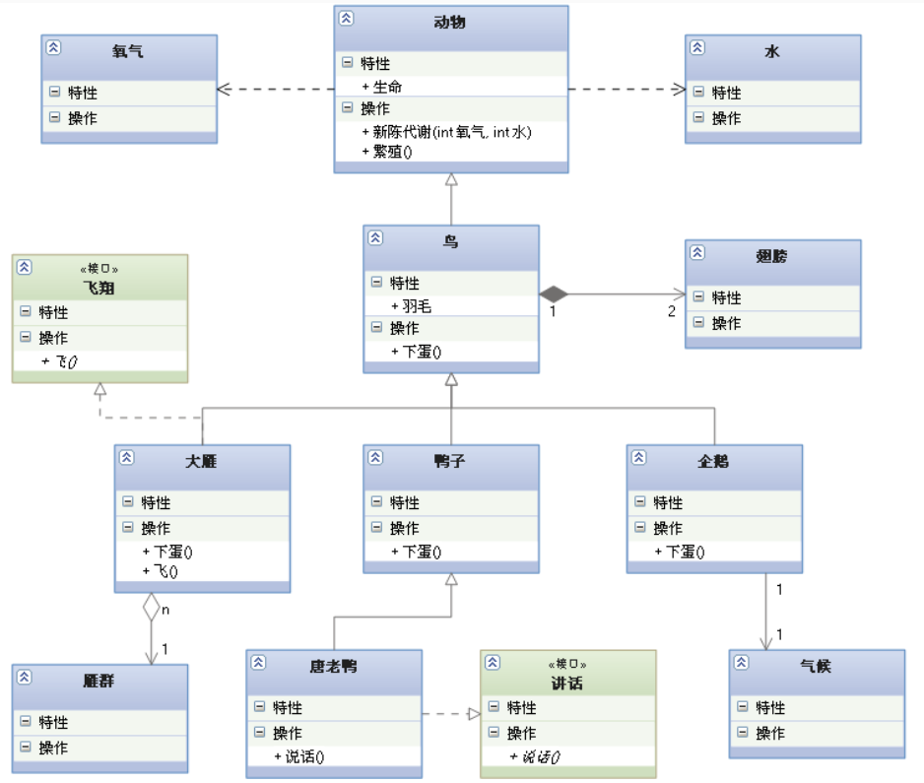
Illustration of the relationships

Slide 43
4.2.2.5 Diagrams in UML
The graphical presentation of a set of elements, most often rendered as a connected graph of vertices(things) and paths( relationships)
Goal: To visualized a system from different perspectives, so a diagram is a projection into a system.
In theory, a diagram may contain any combination of things and relationships

Slide 44
4.2.2.5 Diagrams
Class diagram
Object diagram
Component diagram
Composite structure diagram
Use case diagram
Sequence diagram
Communication diagram
State diagram
Activity diagram
Deployment diagram
Package diagram
Timing diagram
Interaction overview diagram

Slide 45
4.2.2.5 Class Diagram & Component Diagram & Object Diagram
A Class diagram shows a set of classes, interfaces, and collaborations and their relationships.
The most common used diagram
Address the static design/process view of a system
Component diagrams are variants of class diagrams
A Object diagram shows a set of objects and their relationships.
Represent static snapshots of instances of the things found in class diagram
Address the static design/process view of a system, from the perspective of real or prototypical cases

Slide 46
4.2.2.5 Use case Diagram/ Sequence&Communication Diagram
Use case Diagram shows a set of use cases and actors and their relationships → address static use case view of a system
Especially important in organizing and modeling the behavior of a system
Sequence diagram & Communication diagram are both interaction diagram
Shows an interaction, consisting of a set of objects or roles, including messages
Sequence diagram Focus on time-ordering
Communication diagram Focus on structural organization of the objects or roles that send or receive messages

Slide 47
4.2.2.5 State diagram
Shows a state machine, consists of states, transitions, events, and activities
Shows the dynamic view of an object.
Emphasize the event-ordered behavior of an object

Slide 48
4.2.2.5 Activity diagram
Shows the structure of a process or other computation as the flow of control and data from step to step within the computation.
Shows the dynamic view of a system
Especially important in modeling the function of a system and emphasize the flow of control among objects

Slide 49
4.2.2.5 Other diagrams…….
Artifact diagram
Package diagram
Timing diagram
……

Slide 50
4.2.2.6 Rules of UML
To specify what a well-formed model should be like
Syntactic and semantic rules For:
Names – Things, relationship, and diagrams
Scope
Visibility
Integrity– How things properly and consistently relate to one another
Execution – What it means to run or simulate a dynamic model

Slide 51
4.2.2.7 Common mechanism in the UML
Four common mechanism:
Specification
Adornments
Common divisions
Extensibility mechanisms

Slide 52
4.2.2.7 Specification & Adornment
Specification: Provide a semantic backplane that contains all the parts of all the models of a system
Adornment: To include details

Slide 53
4.2.2.7 Common divisions
Division of class and object
Customer
Jan: Customer
Name
Address
Phone
: Customer
Elyse
Similar for almost every building block in UML

Slide 54
4.2.2.7 Common divisions
Separation of interface and implementation
An interface declares a contract
An implementation represents one concrete realization of the contract
Window
IWindow
IPaint
The separation of type and role

Slide 55
4.2.2.7 Extensibility mechanisms
Stereotypes – Extends the vocabulary of the UML
Tagged values – Extends the properties of a UML stereotype
Constraints – Extends the semantics of a UML build block

Slide 56
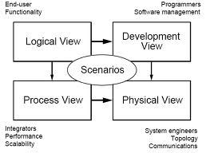
4.2.3 Architecture
Require different views and their management??
  Visualizing, specifying, constructing, documenting
  Different stakeholders ……
Architecture by interlocked views:
  Use case view →System behavior seen by end users
  Design view → functional requirement of the system provided to its end users (Logical view)
  Process view → Flow of control among its various parts, including concurrency and synchronization
  Implementation view → Artifacts used to assemble and release the physical system
  Deployment view → the nodes forming the system’s hardware topology on which the system executes

Slide 57
4.2.4 UML Tools
Rhaphsody
Rational Rose
  Tool for analyzing, designing OO software systems
  Well integrated with ClearCase, RequisitePro
  Widely-used
Borland Together
  Pure Java，Support UML
ArgoUML
  Open source
Visio
Visual UML
MagicDraw
…

Slide 58
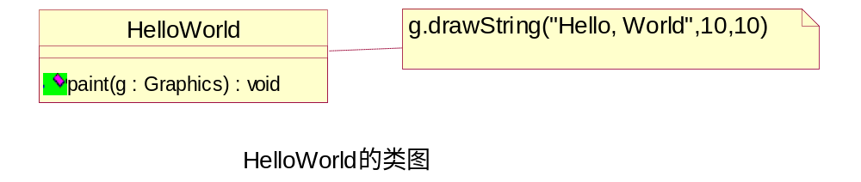
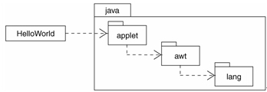
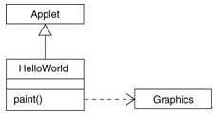
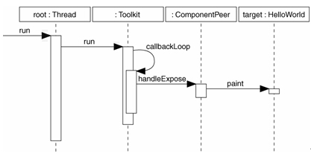
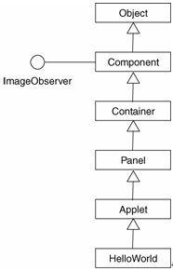
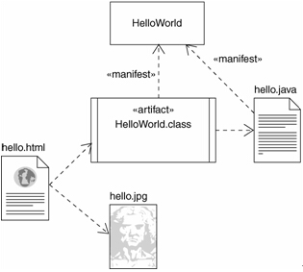
4.2.5 UML Example
import java.awt.Graphics;
class HelloWorld extends java.applet.Applet {
public void paint(Graphics g) {
g.drawString(“Hello, World!”,10,10);
}
}
Output the Java applet of “Hello, World!” in Web Browser
Class Applet is the parent class of HelloWorld； Class Graphics is used the the signature and implementation of the operation paint of class HelloWorld
类图2
依赖包
顺序图
类图3
构件图

Slide 59
4.3 UML Conclusion
UML is a unified language for modeling. It is very important for system analysis and design.
History of UML：
  UML is designed by Booch、Rumbaugh、Jacobson. It is a landmark of software engineering domain
  It is UML that end the jumbled methodological competition of object-oriented domain.
UML adopts the advantages of different methodologies of object oriented technology. The contents of UML are very large which involve many aspects of software engineering. And thus it can be used in many domains.
UML has become a dominant standard modeling language. It has been identified by more and more companies and individuals

Slide 60
Appendix- UML 1.4 and 2.0 model element name differences
UML 1.4 model element name | UML 2.0 model element name
Association end | Member end and Property
Object (when used in activity diagrams) | Object node
Object (when used in sequence diagrams) | Lifeline
Collaboration diagrams | Communication diagrams
Swimlane (or partition) | ActivityPartition
Activity | Structured activity node
Decision | Decision node or merge node
Final State or end state | Final Activity Node
Initial state or start state | Initial node
Object Instance (in activity diagrams) | Central buffer node

Slide 61
UML 1.4 model element name | UML 2.0 model element name
State | Structured activity node
State machine | Structured activity node
Synchronization bar (synch bar) | Fork node or Join node
Transition (on an activity diagram) | Control flow
Transition condition (guard condition) | Control flow guard
Formal Argument | Template Parameter Substitution
Formal Arguments (collection of Formal Arguments) | Template Binding
Three-tiered diagrams | Class diagrams
Class Instance | Lifeline
Self-link | Message pathway
Connection relationship | Communication Path
Process (in a deployment diagram) | Artifact
Processor | Execution environment
Destruction marker | Stop node
Focus of Control | Execution Occurrence
Action | UML activity
State diagram | Statechart diagram

Slide 62
Knowledge
is the torch of wisdom

